Slide 1
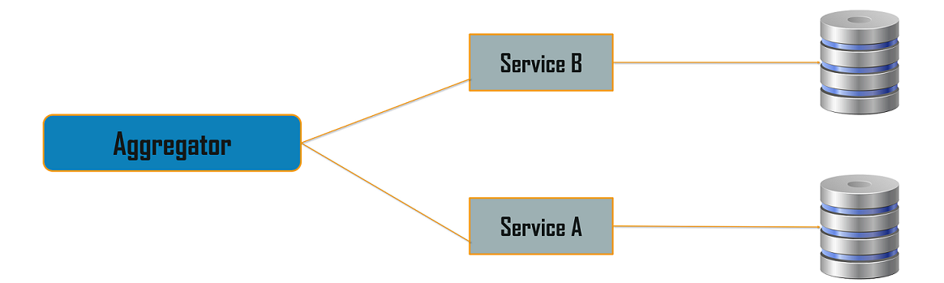
Aggregator Pattern

Slide 2
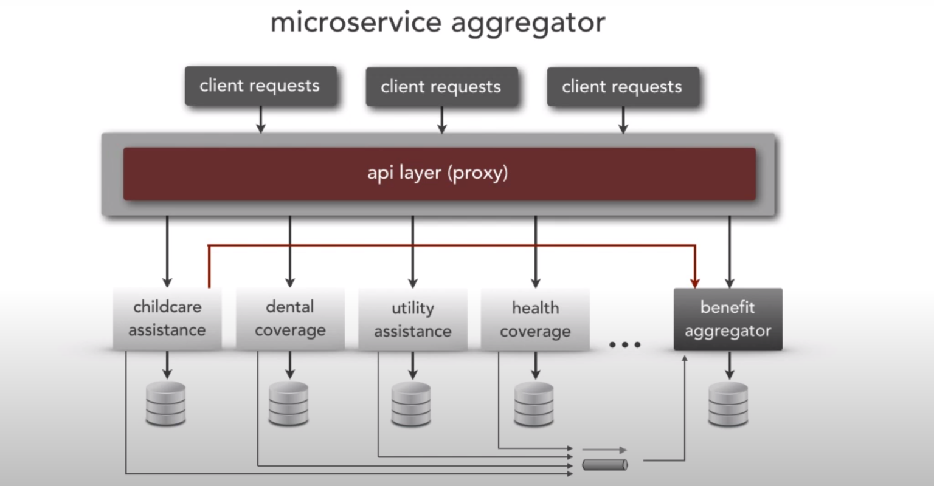

Slide 3
Proxy Pattern
Proxy microservice design pattern is a variation of Aggregator.
Proxy means ‘in place of’, representing’ or ‘in place of’ or ‘on behalf of’ are literal meanings of proxy and that directly explains Proxy Design Pattern.
Proxies are also called surrogates, handles, and wrappers.
They are closely related in structure, but not purpose, to Adapters and Decorators.
A real world example can be a cheque or credit card is a proxy for what is in our bank account. It can be used in place of cash, and provides a means of accessing that cash when required. And that’s exactly what the Proxy pattern does – “Controls and manage access to the object they are protecting“.

Slide 4
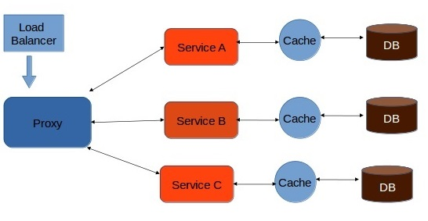
Proxy Pattern

Slide 5
UI composition pattern
The end user interface layer is laid out into various sections, which individually invokes the corresponding microservice asynchronously.
Modern user interfaces use single page application (SPA) built by Angular or ReactJS frameworks.

Slide 6
Backend for frontend
Instead of creating a general-purpose microservice, we can design a microservice and its response specifically for the client agents (such as desktop browsers, mobile devices etc.).
This tight coupling of client agents with the corresponding backend service helps us to efficiently create response data.

Slide 7
Gateway Routing Pattern
The API gateway is responsible for request routing.
An API gateway implements some API operations by routing requests to the corresponding service.
When it receives a request, the API gateway consults a routing map that specifies which service to route the request to.
A routing map might, for example, map an HTTP method and path to the HTTP URL of service.
This function is identical to the reverse proxying features provided by web servers such as NGINX.

Slide 8
Chained Micro Service Pattern
There will be multiple dependencies of for single services or microservice eg: Sale microservice has dependency products microservice and order microservice.
Chained microservice design pattern will help you to provide the consolidated outcome to your request.
The request received by a microservice: 1, which is then communicating with microservice-2 and it may be communicating with microservice-3.
All these services are synchronous calls.

Slide 9
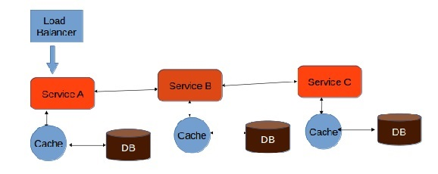
Chained Micro Service Pattern

Slide 10
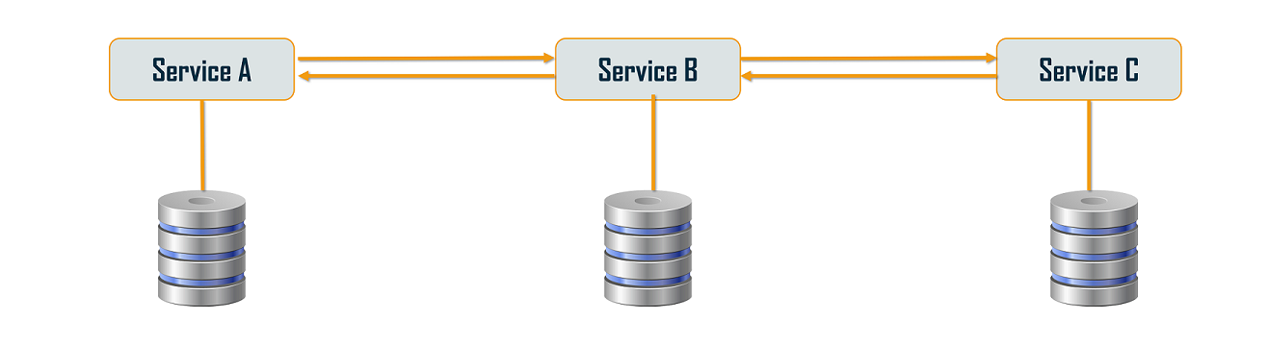
Chained or Chain of Responsibility Pattern

Slide 11
Branch Pattern
Branch microservice is a design pattern in which you can simultaneously process the requests and responses from two or more independent microservices.
So, unlike the chained design pattern, the request is not passed in a sequence, but the request is passed to two or more mutually exclusive microservices chains.
This design pattern extends the Aggregator design pattern and provides the flexibility to produce responses from multiple chains or single chain.
For example, if you consider an e-commerce application, then you may need to retrieve data from multiple sources and this data could be a collaborated output of data from various services.
So, you can use the branch pattern, to retrieve data from multiple sources.

Slide 12
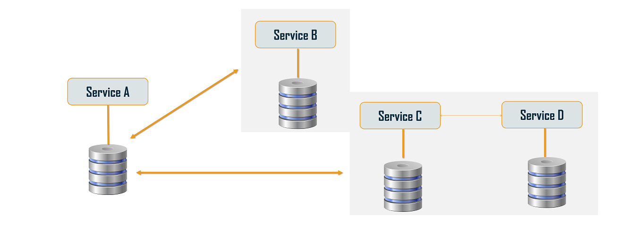
Branch Pattern

Slide 13
Database Patterns

Slide 14
DATA-RELATED PATTERNS
As microservices are self-contained and designed for independent scalability, we end up having service-specific databases (such as database server per service, database schema per service and service-specific tables).
Due to this design, we face challenges such as:
• A single service that reads or updates data from multiple databases
• A single business transaction spanning multiple services and databases
• Replication of data in the databases

Slide 15
Database per Service
To solve the above concerns, one database per microservice must be designed; it must be private to that service only.
It should be accessed by the microservice API only.
It cannot be accessed by other services directly.
For example, for relational databases, we can use private-tables-per-service, schema-per-service, or database-server-per-service.

Slide 16
Shared Database per service
It is an anti-pattern for microservices.
But if the application is a monolith and trying to break into microservices, denormalization is not that easy.
In the later phase, we can move to DB per service pattern.
A shared database per service is not ideal, but that is the working solution for the above scenario.
Most people consider this an anti-pattern for microservices, but for brownfield applications, this is a good start to break the application into smaller logical pieces.
This should not be applied for greenfield applications.

Slide 17
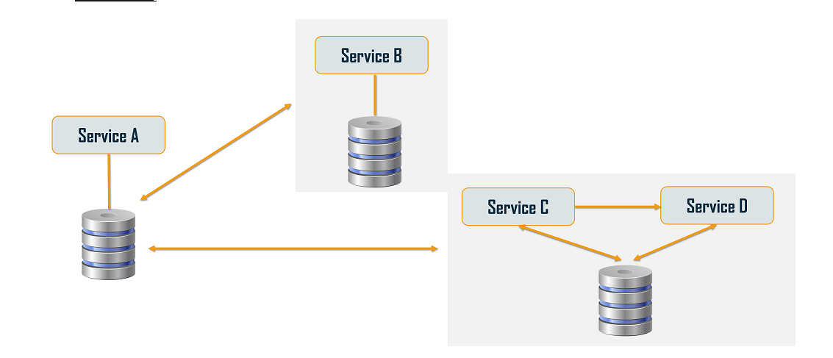
Database or Shared Data Pattern

Slide 18
Command Query Responsibility Segregation (CQRS)
Database handling is split into two categories, the command part for handling data creation, update, deletion and the query part that uses materialized views to retrieve data.
The materialized view is updated by subscribing to data change events.
Event sourcing pattern is used along with CQRS to create immutable events.

Slide 19
Command Query Responsibility Segregation (CQRS)
Once we implement database-per-service, there is a requirement to query, which requires joint data from multiple services.
CQRS suggests splitting the application into two parts — the command side and the query side.
The command side handles the Create, Update, and Delete requests.
The query side handles the query part by using the materialized views.

Slide 20
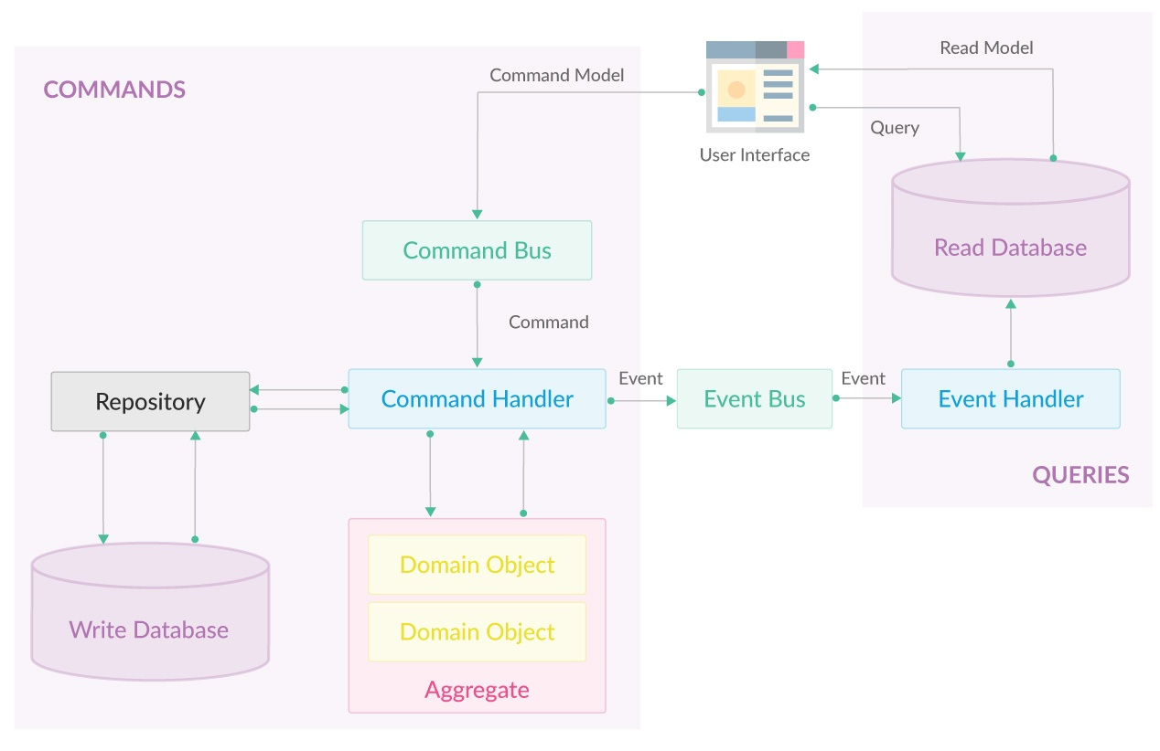
Command Query Responsibility Segregation (CQRS)

Slide 21
Command Query Responsibility Segregation (CQRS)
Commands represent user intent. They contain all the necessary information about actions that user would like to perform.
Command Bus is a type of queue that receives commands and passes them to Command Handlers.
Command Handlers contain actual business logic which validates and processes data received in commands. Command handlers are responsible for generation and propagation of domain events to Event Bus
Event Bus dispatches events to event handlers subscribed for specific event types. Event bus can propagate events both asynchronously or synchronously if consecutive events are dependent.
Event Handlers are responsible for handling specific incoming events. Their role is to save the new state of the application in read repository, and perform terminal actions like sending emails, storing files etc.

Slide 22
Command Query Responsibility Segregation (CQRS)
Queries are objects, which represent the actual state of application available for a user. Getting data for UI should be done through these objects.
We can distinguish many advantages of CQRS approach including the following:
We can split development tasks between people more experienced who will be working on the business logic and those ones who will be working on queries part.
We have to be careful because this advantage may hurt knowledge transfer.
We can achieve a great read/write performance by scaling commands and queries on multiple different servers.

Slide 23
Command Query Responsibility Segregation (CQRS)
Using two different repositories (read/write) which are synchronized gives us automatic backup without any additional effort.
Reads don’t hit write database, so they can go faster when using Event Sourcing.
We can structure read data directly for the views, without thinking about domain logic, which simplifies views and can improve performance.

Slide 24
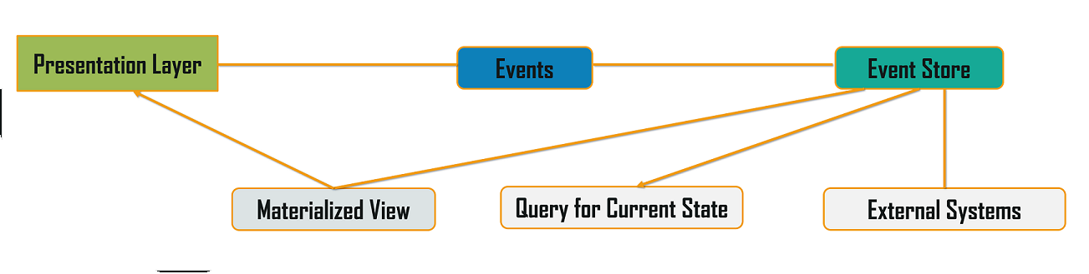
Event Sourcing Design Pattern

Slide 25
Event Sourcing
The event sourcing pattern is generally used along with it to create events for any data change.
Materialized views are kept updated by subscribing to the stream of events.
Event Sourcing Most applications work with data, and the typical approach is for the application to maintain the current state.
For example, in the traditional create, read, update, and delete (CRUD) model a typical data process is to read data from the store.
It contains limitations of locking the data, often using transactions.

Slide 26
Event Sourcing
The Event Sourcing pattern defines an approach to handle operations on data that’s driven by a sequence of events, each of which is recorded in an append-only store.
Application code sends a series of events that imperatively describe each action that has occurred on the data to the event store, where they’re persisted.
Each event represents a set of changes to the data (such as AddedItemToOrder).
The events are persisted in an event store that acts as the system of record.

Slide 27
Event Sourcing
Typical uses of the events published by the event store are to maintain materialized views of entities as actions in the application change them, and for integration with external systems.
For example, a system can maintain a materialized view of all customer orders that are used to populate parts of the UI.
As the application adds new orders, adds or removes items on the order, and adds shipping information, the events that describe these changes can be handled and used to update the materialized view. .

Slide 28
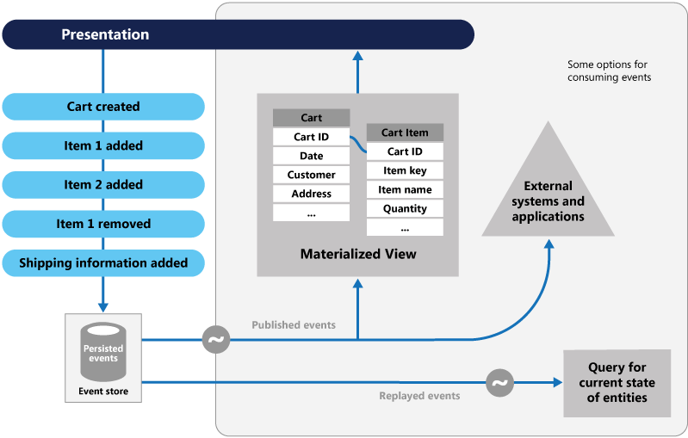
Event Sourcing

Slide 29
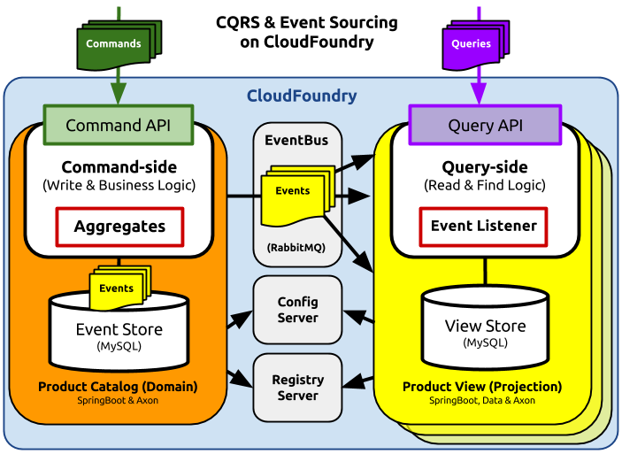
Event Sourcing

Slide 30
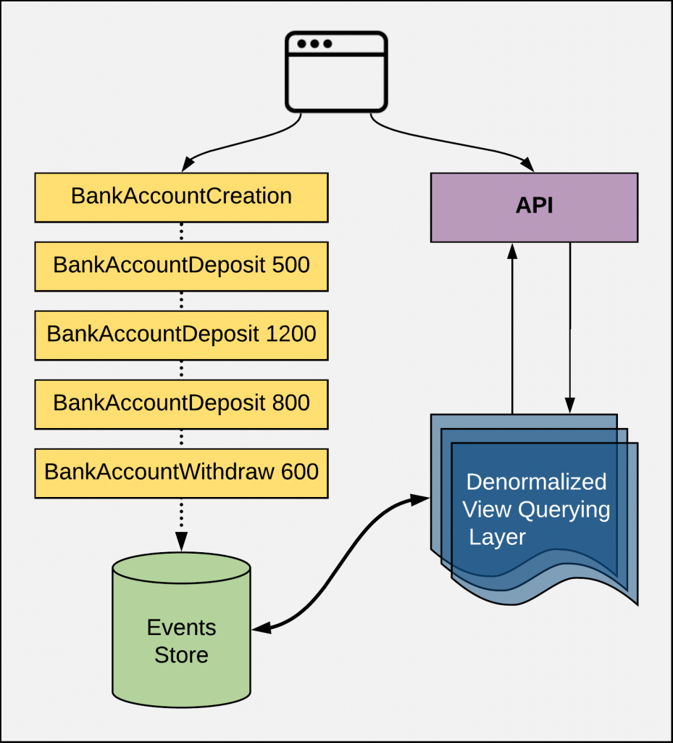
Event Sourcing

Slide 31
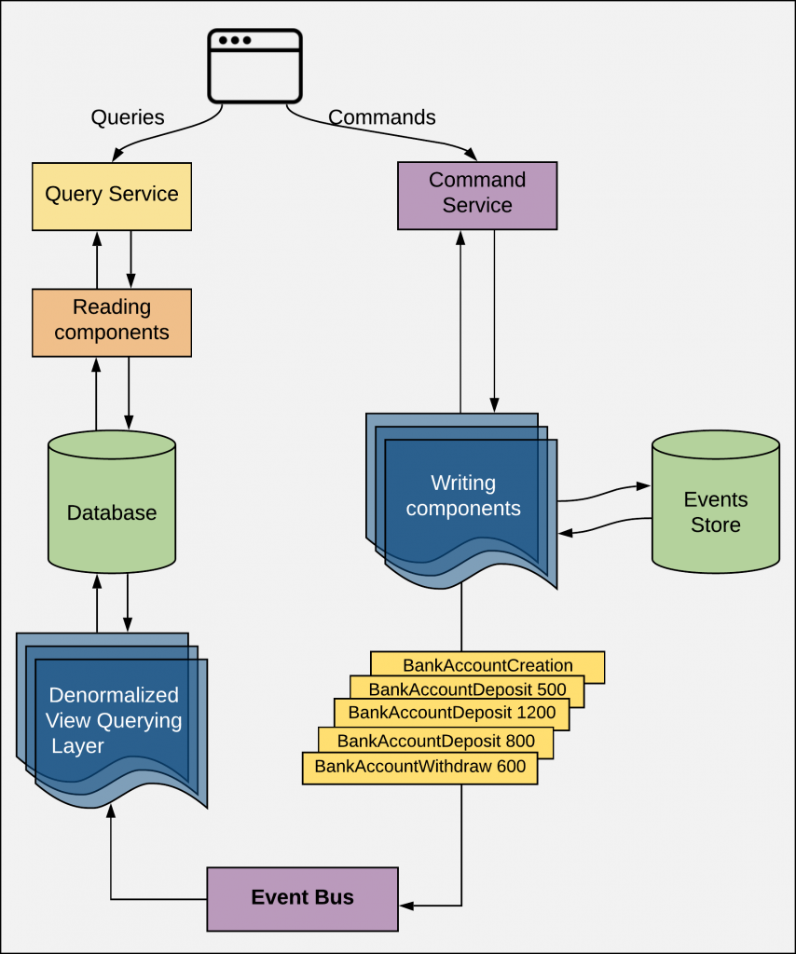
CQRS and Event Sourcing

Slide 32
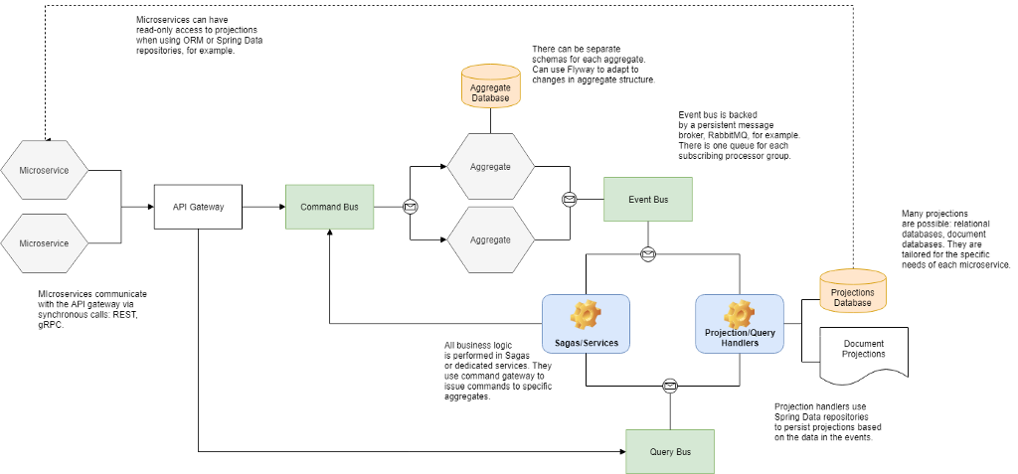

Slide 33
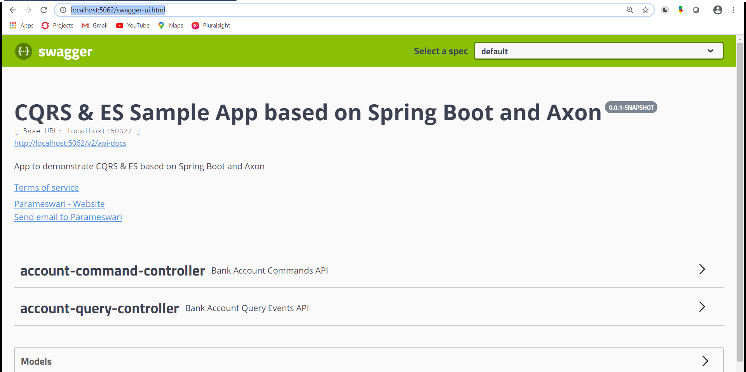

Slide 34
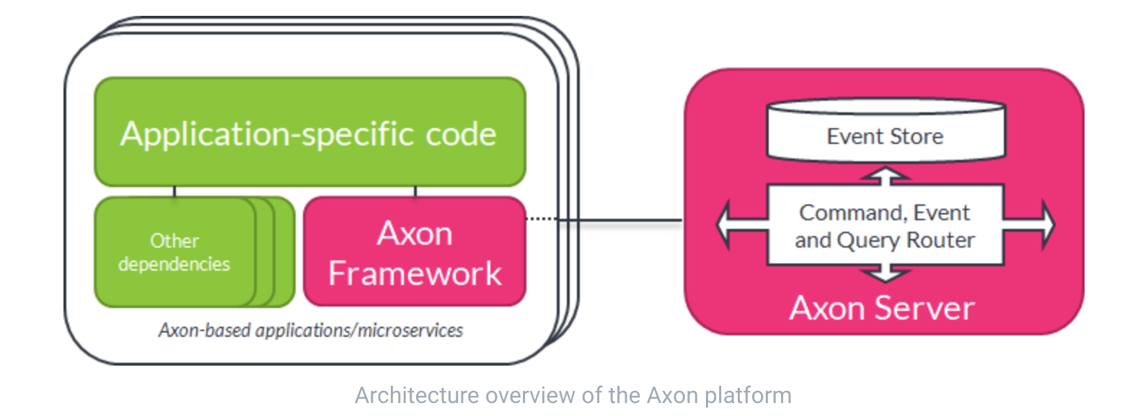
Axon

Slide 35
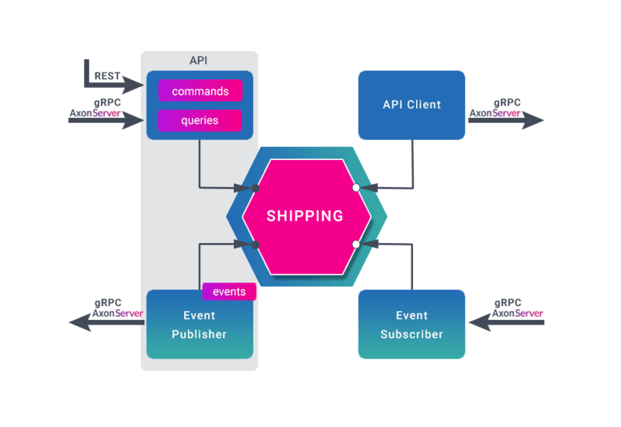
Axon

Slide 36
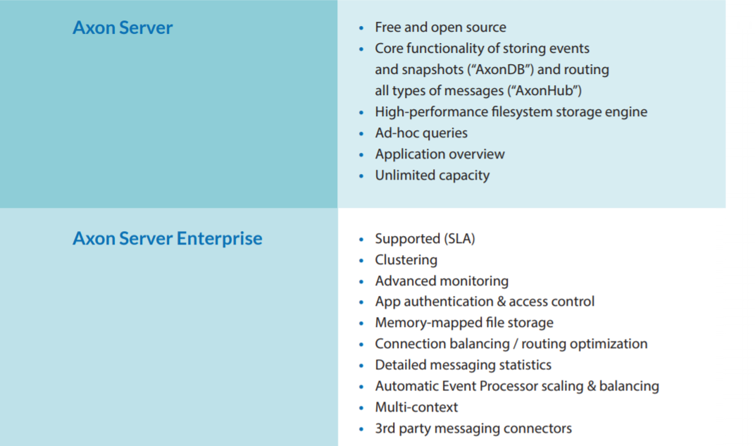
Axon

Slide 37
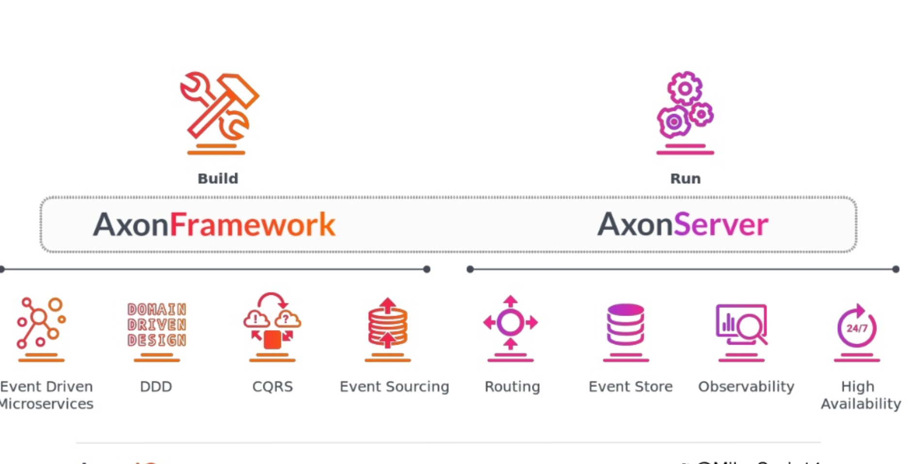
Axon

Slide 38
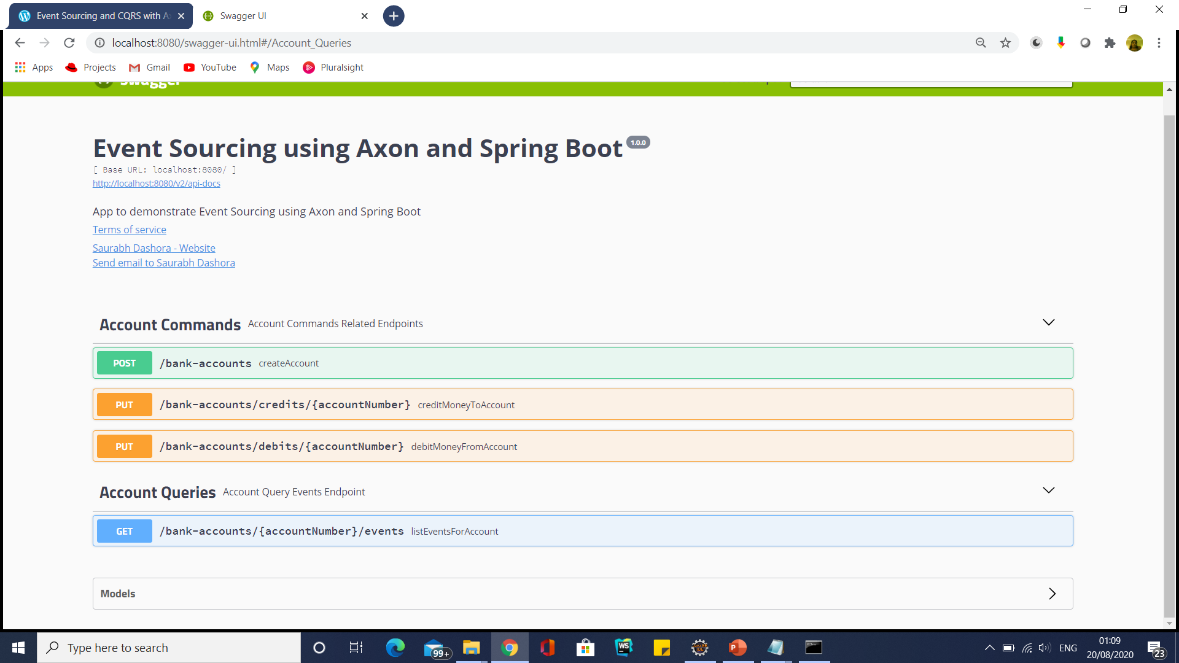
AxonFramework Accounts

Slide 39
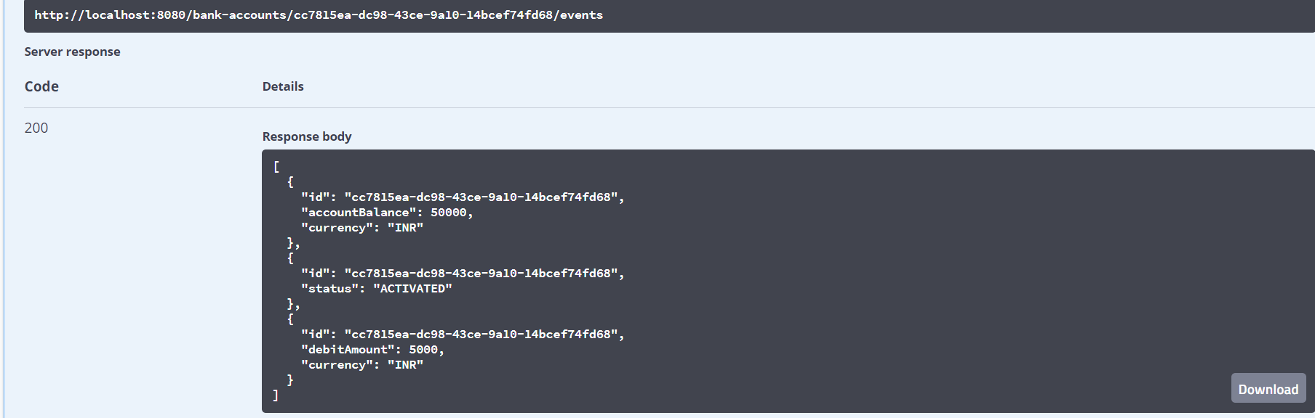
AxonFramework Accounts
Create Account
Debit Money
List Events using swagger

Slide 40
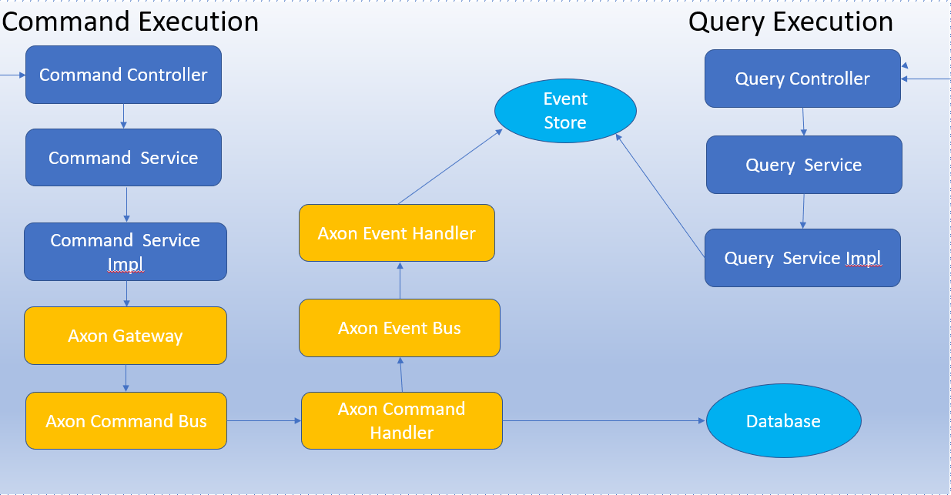
AxonFramework Accounts

Slide 41
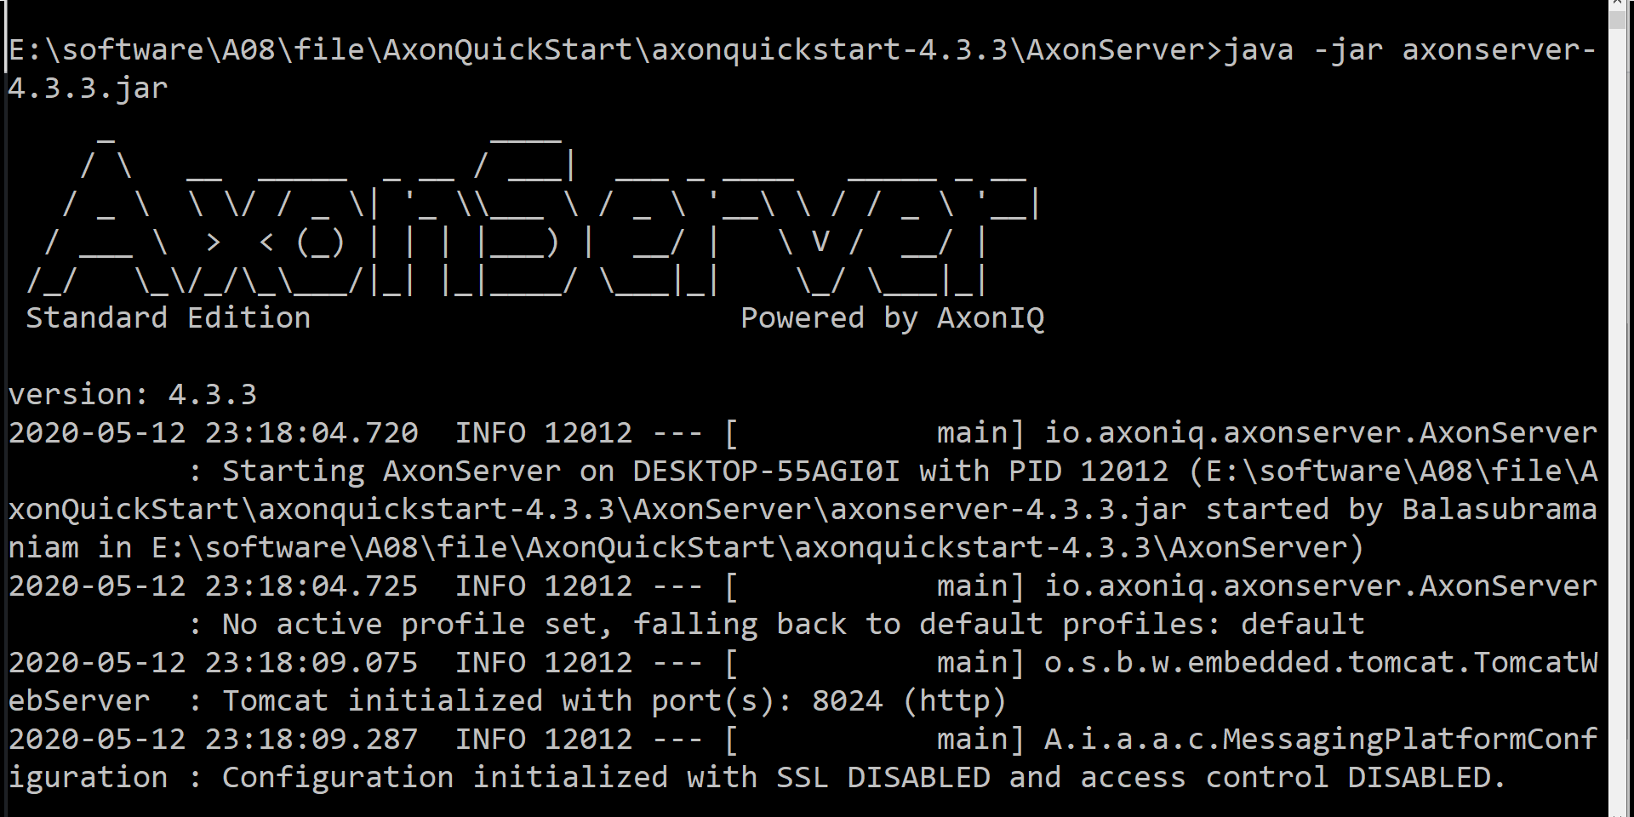
Event Sourcing

Slide 42
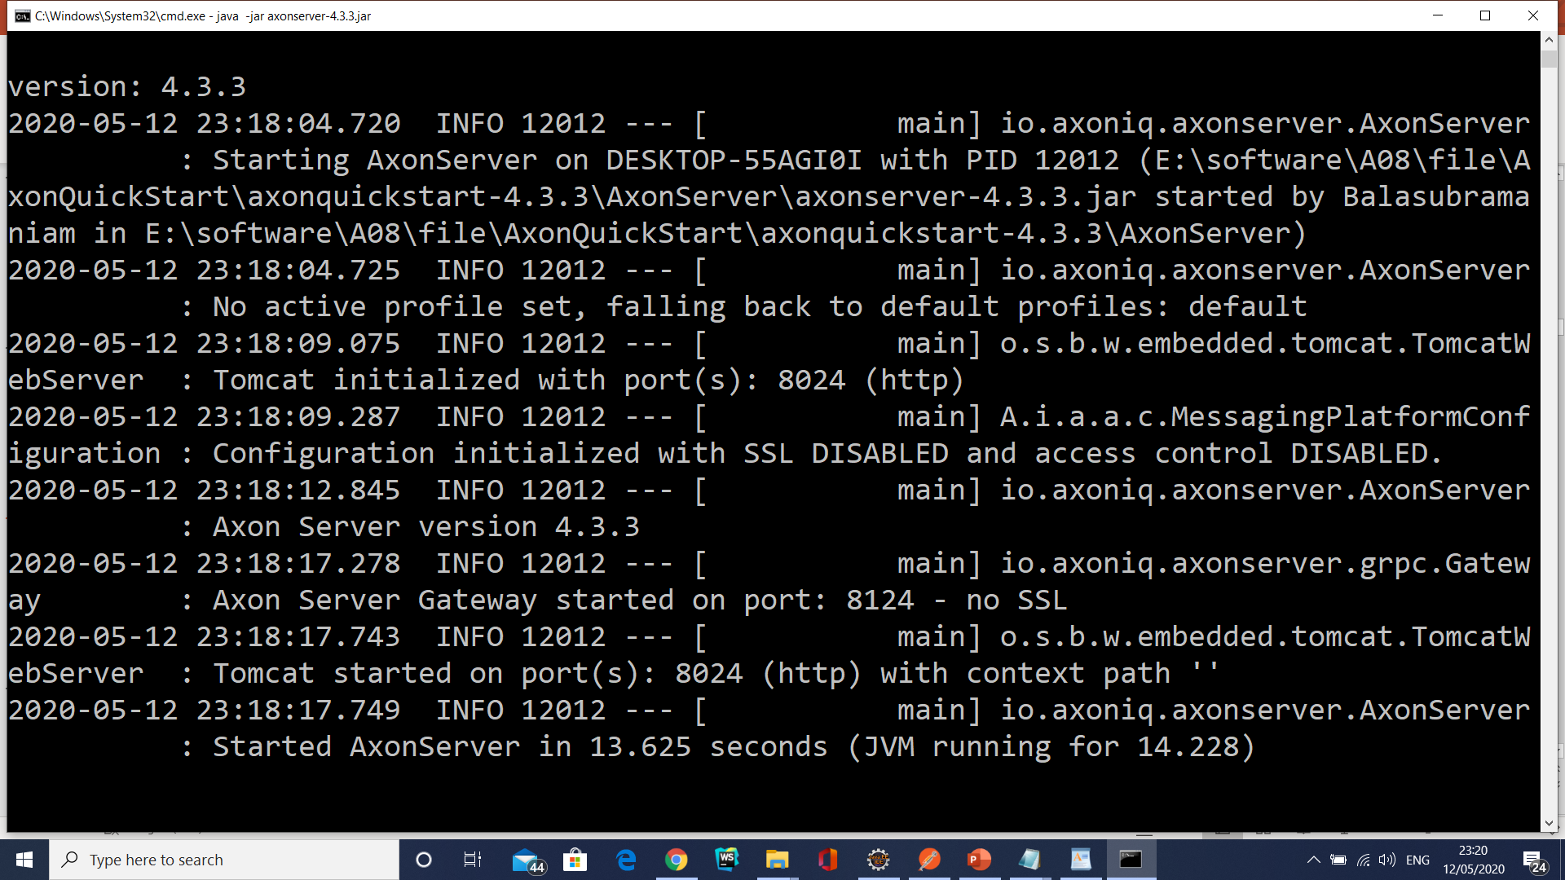
Event Sourcing

Slide 43
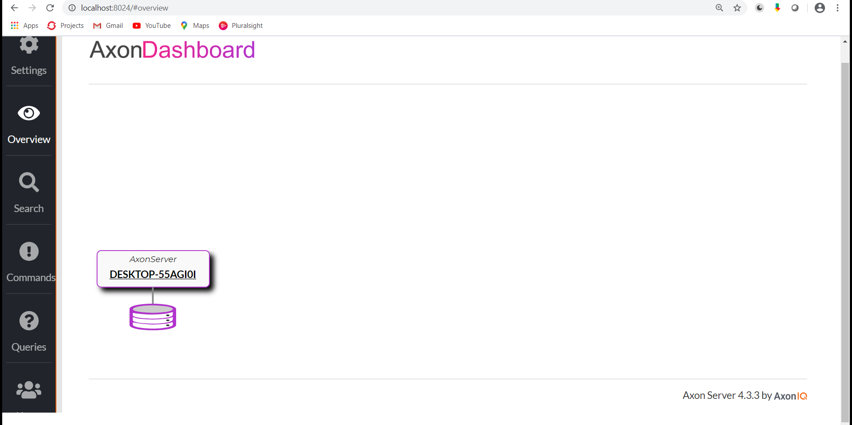
Event Sourcing

Slide 44
Event Sourcing
Add a bank:
POST: http://localhost:5060/api/bank
BODY:
{
“bankId": 1,
“bankName": “SBI"
}

Slide 45
Event Sourcing
Add a branch:
POST: http://localhost:5060/api/bank/1/branch
BODY:
{
“branchId":"123460",
“branchName": “Villivakkam",
"address": “PH Road"
}

Slide 46
Event Sourcing
Get branches in a Bank:
GET: http://localhost:5060/api/bank/1/branch
Get Branch:
GET: http://localhost:5060/api/bank/1

Slide 47
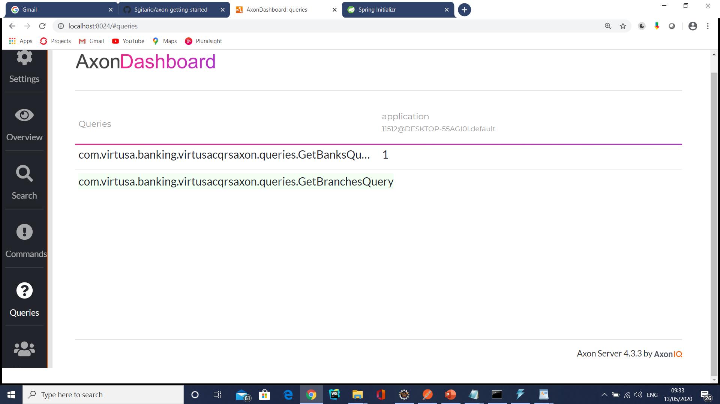
Event Sourcing

Slide 48
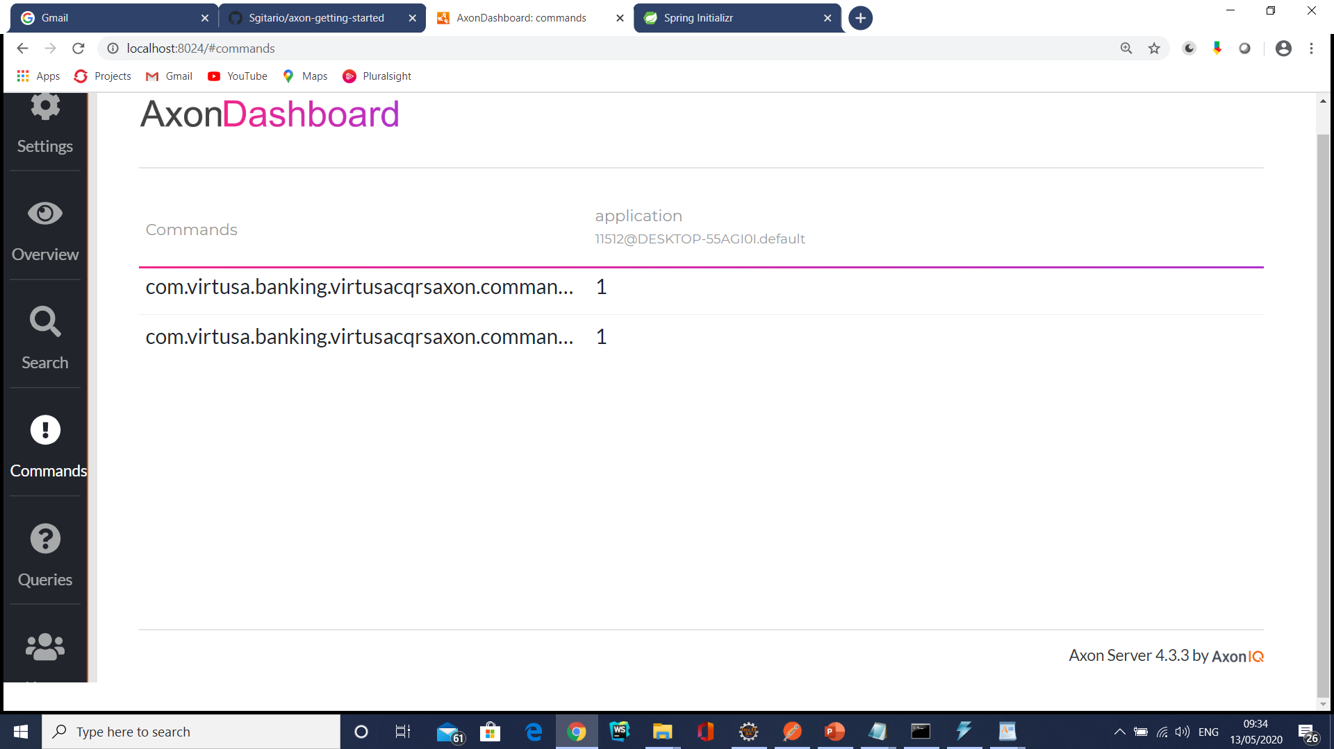
Event Sourcing

Slide 49
Saga Pattern
When a business transaction needs to manage data consistency that is spread across multiple databases,we could use Saga pattern.
As a part of the Saga pattern, each transaction is orchestrated locally or centrally to execute it entirely and handle the failure/rollback scenario.
For instance, if a business transaction needs to handle data related to order and customer service, each of these services produces and listens to each other to handle the transaction.

Slide 50
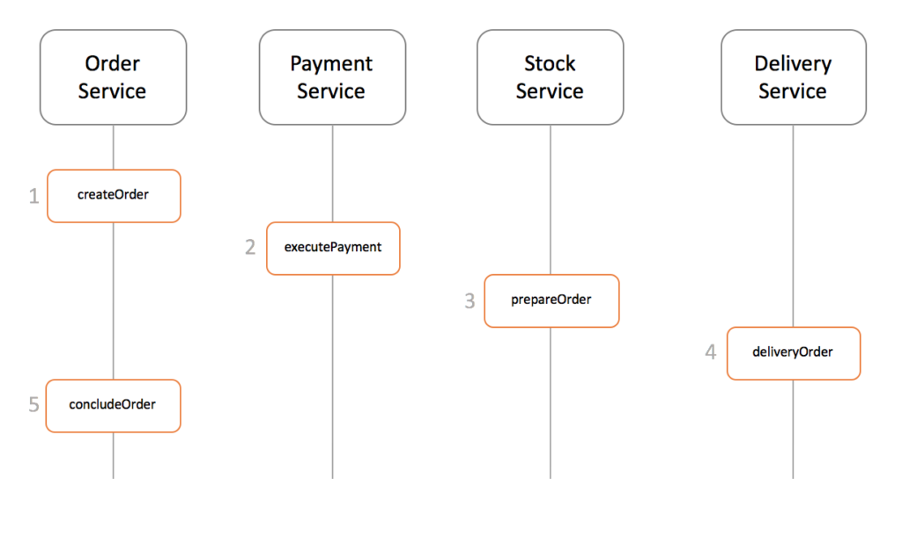
Saga Design Pattern

Slide 51
Saga Pattern
When each service has its own database and a business transaction spans multiple services, how do we ensure data consistency across services?
Each request has a compensating request that is executed when the request fails.
It can be implemented in two ways:
Choreography — When there is no central coordination, each service produces and listens to another service’s events and decides if an action should be taken or not.
Choreography is a way of specifying how two or more parties; none of which have any control over the other parties’ processes, or perhaps any visibility of those processes — can coordinate their activities and processes to share information and value.

Slide 52
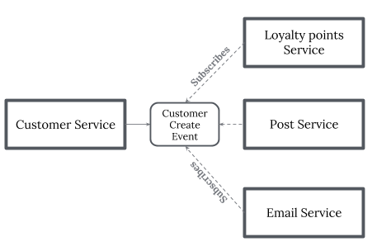
Saga Pattern
Use choreography when coordination across domains of control/visibility is required.
It dictates acceptable patterns of requests and responses between parties.

Slide 53
Saga Pattern Command Orchestration
Orchestration — An orchestrator (object) takes responsibility for a saga’s decision making and sequencing business logic.
when you have control over all the actors in a process. when they’re all in one domain of control and you can control the flow of activities.
This is, of course, most often when you’re specifying a business process that will be enacted inside one organization that you have control over.

Slide 54
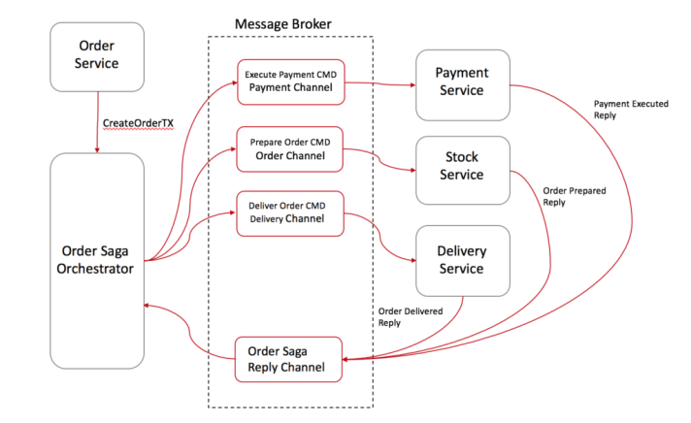
Saga Pattern Command Orchestration

Slide 55
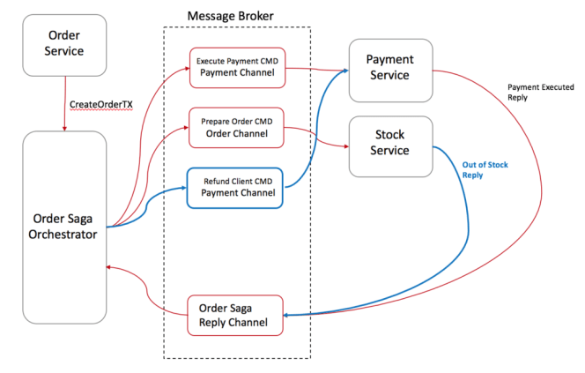
Saga Pattern Command Orchestration
Roll back

Slide 56
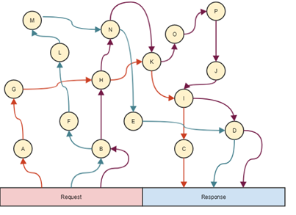
Saga Pattern

Slide 57
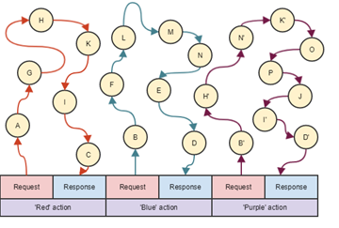
Saga Pattern

Slide 58
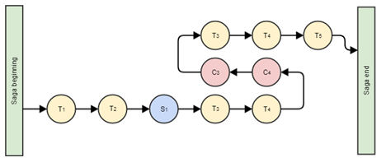
Saga Pattern

Slide 59
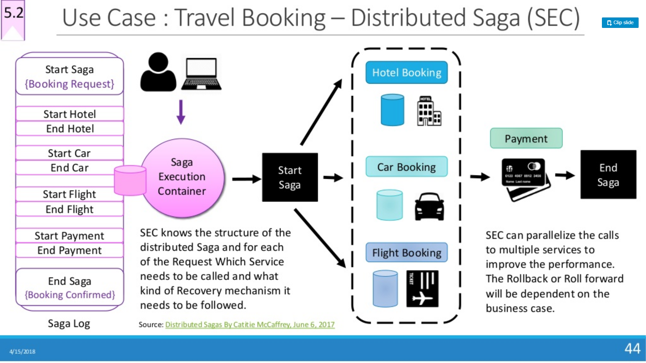

Slide 60
Saga Design Pattern
Events/Choreography: When there is no central coordination, each service produces and listen to other service’s events and decides if an action should be taken or not.
In the orchestration approach, we define a new service with the sole responsibility of telling each participant what to do and when. The saga pattern orchestrator communicates with each service in a command/reply style telling them what operation should be performed.

Slide 61
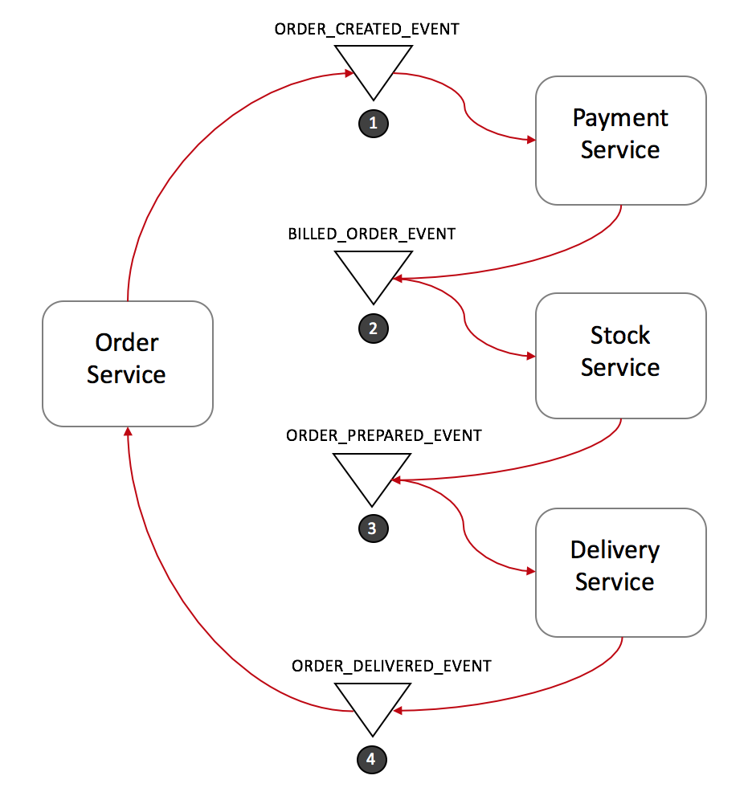
Event Choreography

Slide 62
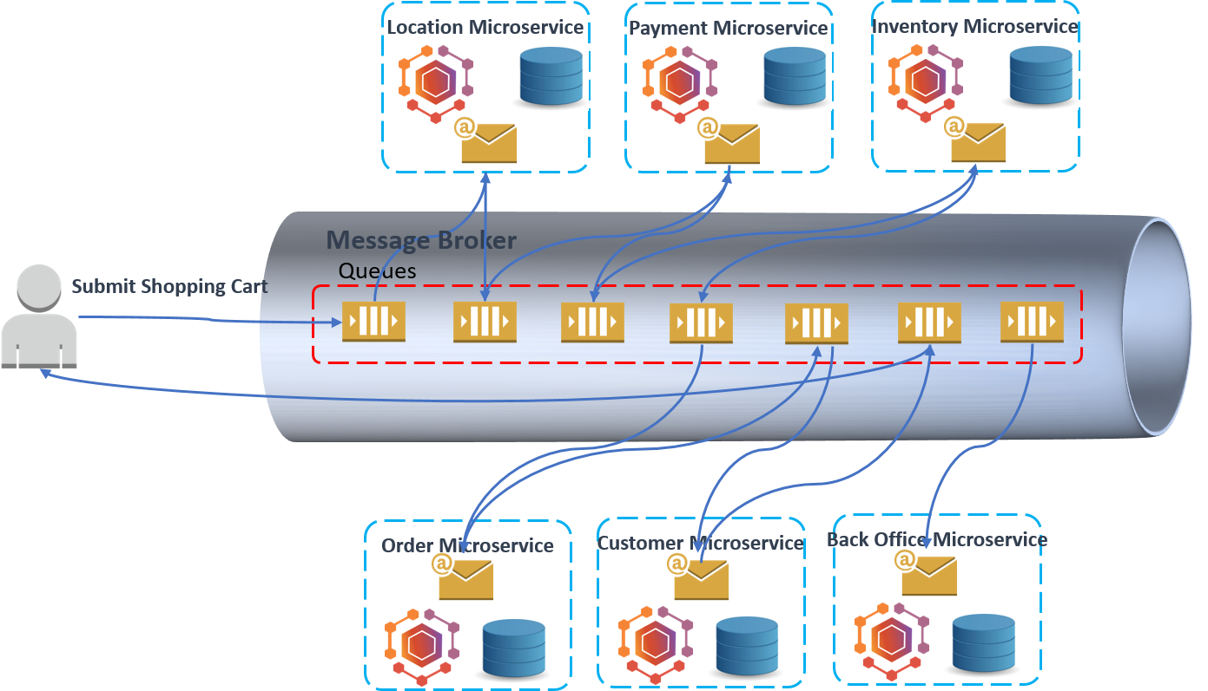
Event Choreography

Slide 63
Event-Driven Service Choreography
Difficult to maintain: Due to the decentralized solution, the business flow is spreading across multiple services. Any business change to the process flow will lead to changes in multiple services.
Difficult to manage: The runtime state of the process instance is stored separately.
Difficult to rollback: The business process is choreographed by multiple services which leave the transaction’s ACID becomes extremely difficult.

Slide 64
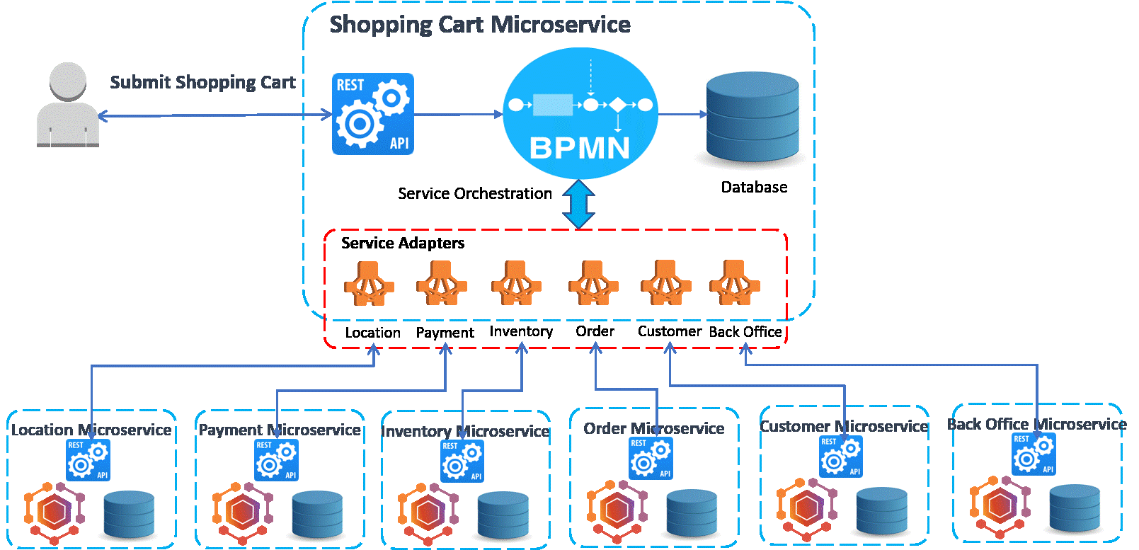
Centralized Service Orchestration

Slide 65
Centralized Service Orchestration
Easy to maintain: the business flow is modeled as graphical BPMN process in a centralized orchestration microservice. The standard Business Process Model and Notation (BPMN) grants the businesses with the capability of understanding their internal business procedures in a graphical notation. Furthermore, organizations can better communicate and report these procedures in a standard manner. Any further changes to the process flow will be mitigated by implementing the workflow diagrams.
Easy to manage: BPMN process engine keeps track of all process instances, their state, audit and statistics information.
Easy to rollback: Transaction's ACID can be guaranteed by the compensation flow as the BPMN out-of-the-box feature.

Slide 66
Centralized Service Orchestration
Tight-coupling: The orchestration pattern must build and maintain a point-to-point connection between the services. Point-to-point means that one service calls the API of another service which results in a mesh of communication paths between all services. Integrating, changing or removing services from the service repository will be a hard task since you must be aware of each connection between the services.
Complexity in building service adapters: Orchestration service need to develop adapters to the peer services, which must maintain all details of the service communications, such as service location, service interfaces, and data model translation. Whenever a peer service changes, the adapter will be impacted.

Slide 67
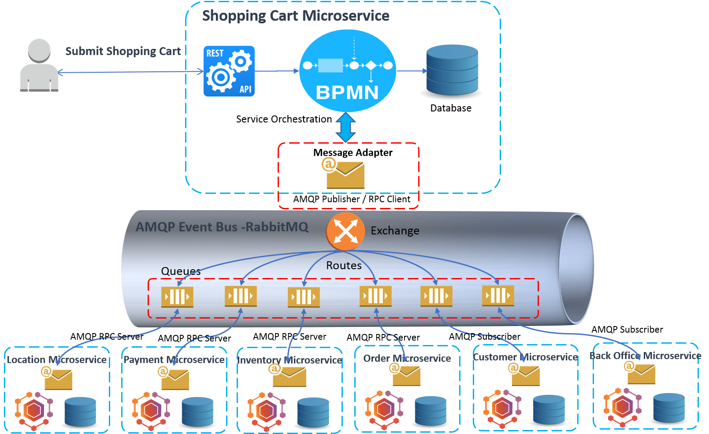
Centralized Service Orchestration

Slide 68
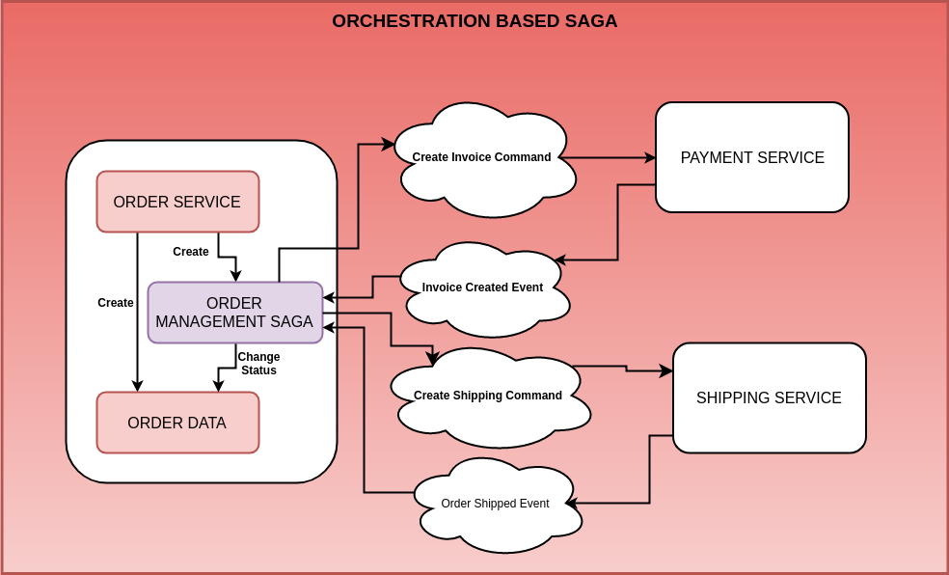
Saga Pattern

Slide 69
High-Level Components
Order Service
Payment Service
Shipping Service
Core-APIs – Integration glue
Axon Server – Axon Server is part of the Axon Platform.

Slide 70
Observability Pattern

Slide 71
Log Aggregation
Since microservices are deployed into individual containers, the logs generated by each of the containers (a.k.a pods) need to be aggregated to create a centralized log repository.
Microservices can log to standard output or to a log file.
The log management systems such as Splunk or Kibana can aggregate the log stream in real time to a centralized log repository and we can query the real-time logs.

Slide 72
Performance Metrics
Performance monitoring services such as Prometheus, AppDynamics and NewRelic can be used to monitor the performance metrics of microservices.
The performance metrics are depicted visually and we can configure the performance thresholds and notification triggers.

Slide 73
Distributed Tracing
When the request flows across various layers and microservices, it is necessary to trace the request end-to-end for error handling and for performance troubleshooting scenarios.
In distributed tracking, we create a unique request ID (such as x-request-id) that is passed across all layers and microservices and logged for troubleshooting purposes.

Slide 74
Health Checks
In order to properly distribute the load and route the traffic accordingly, each microservice has to publish health check endpoint (such as /health) that provides the status of the overall health of the service.
The health check service should check the status of dependent systems (such as databases, storage systems) and host connectivity to provide the overall health status of the service.

Slide 75
CROSS-CUTTING CONCERN PATTERNS

Slide 76
External Configuration
All environment-specific configurations such as connection strings, application properties and URLs should be loaded from an external configuration file.
The CI/CD pipeline can inject the environment-specific configuration values during the build.

Slide 77
Service Discovery
Centralized service discovery module should handle the responsibilities such as service registration/ de-registration and request routing, based on service health.
For client side service discovery service registry is used for load balancing and for server side service discovery, server side load balancing is used.

Slide 78
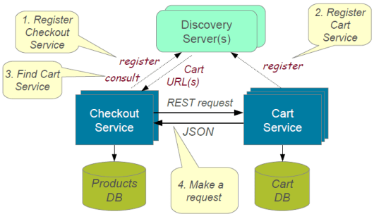
Service Discovery

Slide 79
The circuit breaker
When one of the services in the request-processing pipeline fails, the circuit breaker is responsible in terms of handling the failure and preventing the cascading of the error.
The circuit breaker can monitor the error from a dependent service and fallback to a default handler in case of error.
Netflix Hysterix is an example of a circuit breaker

Slide 80
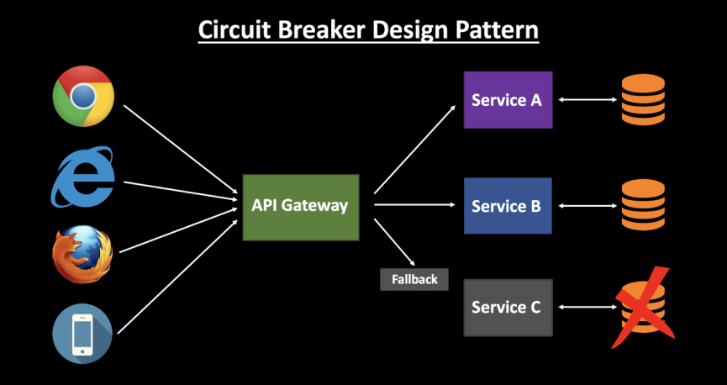

Slide 81
Solutions to Challenges with Microservice Architectures
Spring Boot
Enable building production ready applications quickly
Provide non-functional features
embedded servers (easy deployment with containers)
metrics (monitoring)
health checks (monitoring)
externalized configuration

Slide 82
Examples of Microservices Frameworks for Java
There are several microservices frameworks that you can use for developing for Java. Some of these are:
Spring Boot. This is probably the best Java microservices framework that works on top of languages for Inversion of Control, Aspect Oriented Programming, and others.
Jersey. This open source framework supports JAX-RS APIs in Java is very easy to use.
Swagger. Helps you in documenting API as well as gives you a development portal, which allows users to test your APIs.

Slide 83
Pros
Microservice architecture gives developers the freedom to independently develop and deploy services
A microservice can be developed by a fairly small team
Code for different services can be written in different languages (though many practitioners discourage it)
Easy integration and automatic deployment (using open-source continuous integration tools such as Jenkins, Hudson, etc.)

Slide 84
Pros
Easy to understand and modify for developers, thus can help a new team member become productive quickly
The developers can make use of the latest technologies
The code is organized around business capabilities
Starts the web container more quickly, so the deployment is also faster

Slide 85
Pros
When change is required in a certain part of the application, only the related service can be modified and redeployed—no need to modify and redeploy the entire application
Better fault isolation: if one microservice fails, the other will continue to work (although one problematic area of a monolith application can jeopardize the entire system)
Easy to scale and integrate with third-party services
No long-term commitment to technology stack

Slide 86
Cons
Due to distributed deployment, testing can become complicated and tedious
Increasing number of services can result in information barriers
The architecture brings additional complexity as the developers have to mitigate fault tolerance, network latency, and deal with a variety of message formats as well as load balancing
Being a distributed system, it can result in duplication of effort

Slide 87
Cons
When number of services increases, integration and managing whole products can become complicated
In addition to several complexities of monolithic architecture, the developers have to deal with the additional complexity of a distributed system
Developers have to put additional effort into implementing the mechanism of communication between the services

Slide 88
Cons
Handling use cases that span more than one service without using distributed transactions is not only tough but also requires communication and cooperation between different teams
The architecture usually results in increased memory consumption
Partitioning the application into microservices is very much an art.

Slide 89
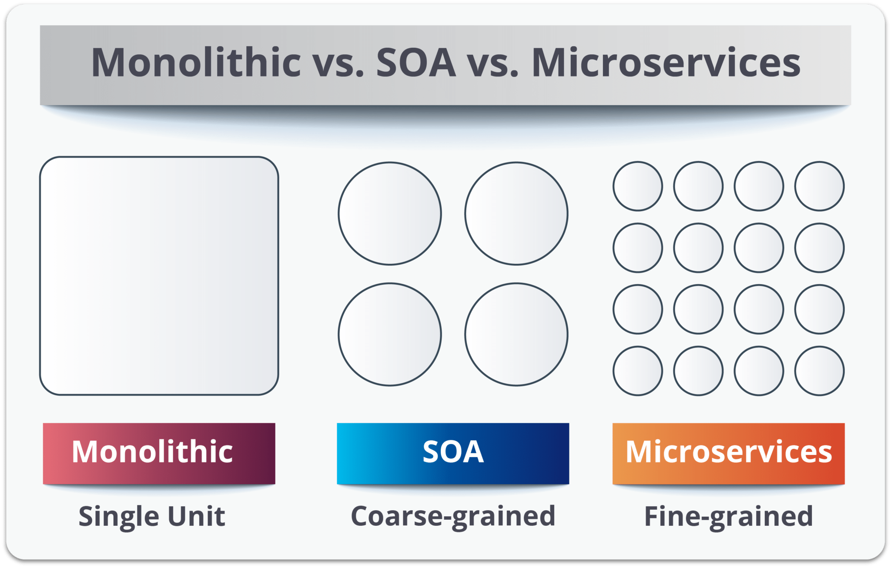
SOA vs Microservices

Slide 90
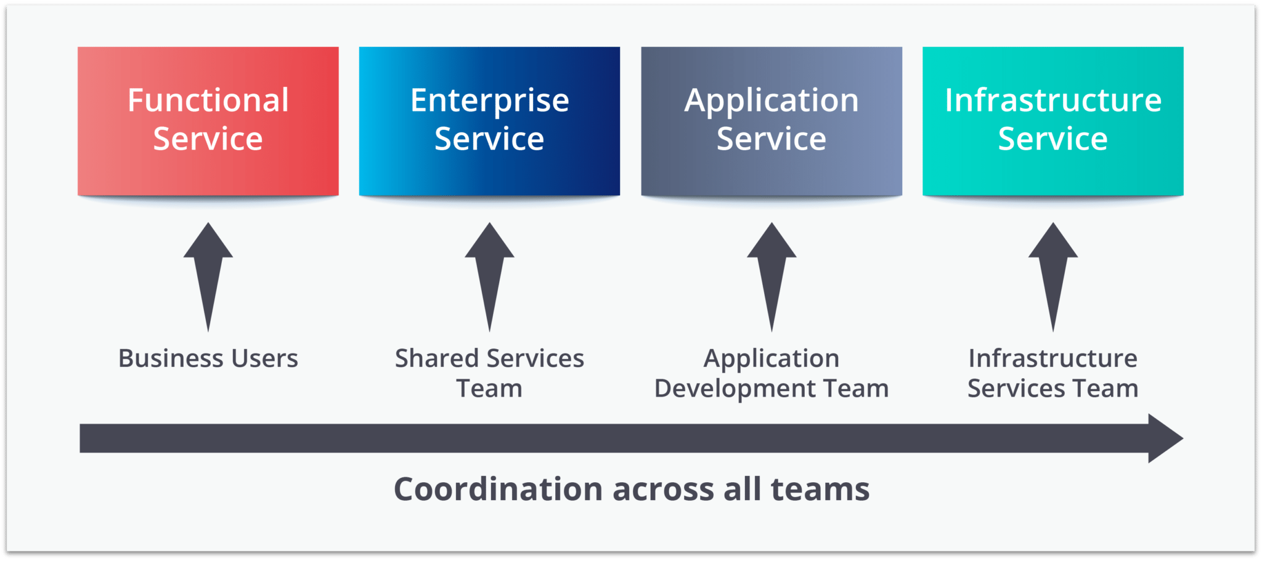
Service Oriented Architecture

Slide 91
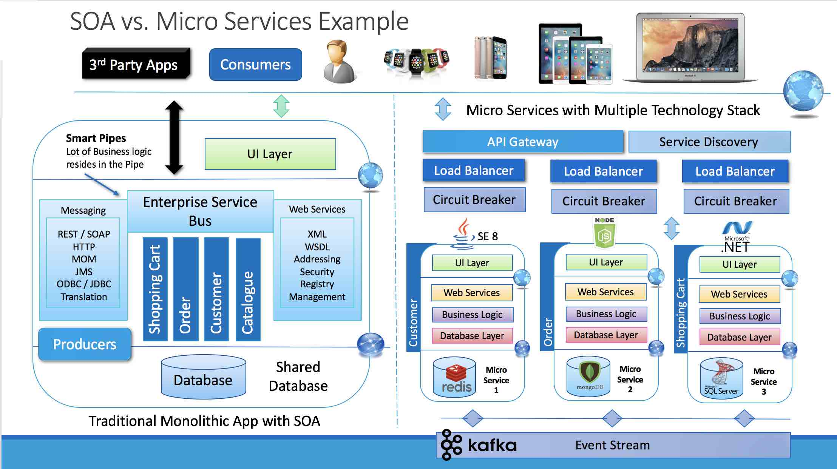

Slide 92
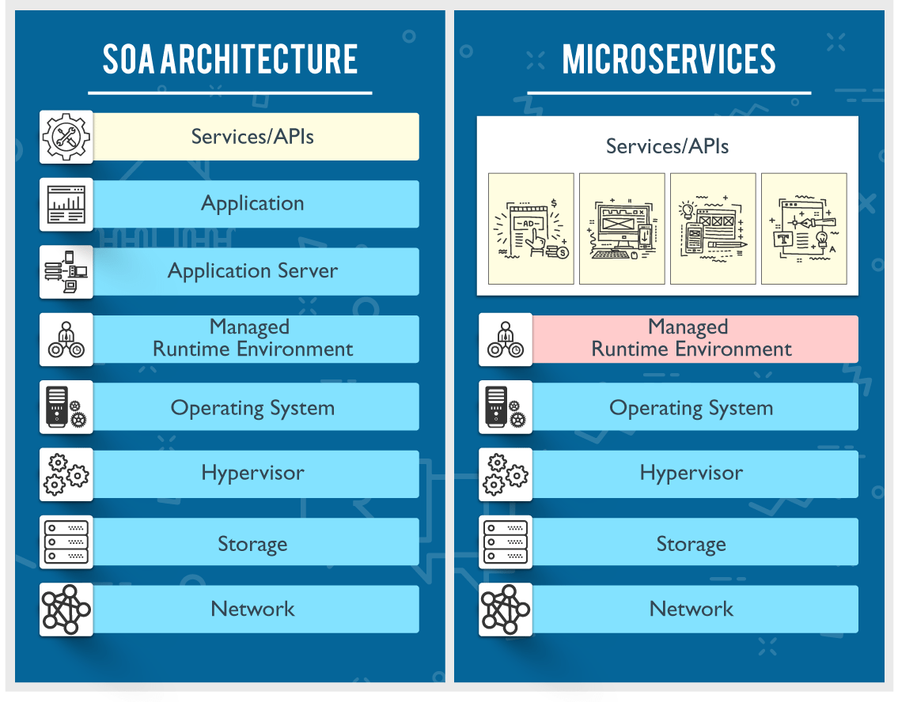

Slide 93
SOA | MSA
Follows “share-as-much-as-possible” architecture approach | Follows “share-as-little-as-possible” architecture approach
Importance is on business functionality reuse | Importance is on the concept of “bounded context”
They have common governance and standards | They focus on people collaboration and freedom of other options
Uses Enterprise Service bus (ESB) for communication | Simple messaging system
They support multiple message protocols | They use lightweight protocols such as HTTP/REST etc.
Multi-threaded with more overheads to handle I/O | Single-threaded usually with the use of Event Loop features for non-locking I/O handling
Maximizes application service reusability | Focuses on decoupling
Traditional Relational Databases are more often used | Modern Relational Databases are more often used
A systematic change requires modifying the monolith | A systematic change is to create a new service
DevOps / Continuous Delivery is becoming popular, but not yet mainstream | Strong focus on DevOps / Continuous Delivery

Slide 94
Challenges with Microservice Architectures
Quick Setup needed : You cannot spend a month setting up each microservice. You should be able to create microservices quickly.
Automation : Because there are a number of smaller components instead of a monolith, you need to automate everything - Builds, Deployment, Monitoring etc.
Visibility : You now have a number of smaller components to deploy and maintain. Maybe 100 or maybe 1000 components. You should be able to monitor and identify problems automatically. You need great visibility around all the components.

Slide 95
Challenges with Microservice Architectures
Bounded Context : Deciding the boundaries of a microservice is not an easy task. Bounded Contexts from Domain Driven Design is a good starting point. Your understanding of the domain evolves over a period of time. You need to ensure that the microservice boundaries evolve.
Configuration Management : You need to maintain configurations for hundreds of components across environments. You would need a Configuration Management solution
Dynamic Scale Up and Scale Down : The advantages of microservices will only be realized if your applications can scaled up and down easily in the cloud.
Pack of Cards : If a microservice at the bottom of the call chain fails, it can have knock on effects on all other microservices. Microservices should be fault tolerant by Design.

Slide 96
Challenges with Microservice Architectures
Debugging : When there is a problem that needs investigation, you might need to look into multiple services across different components. Centralized Logging and Dashboards are essential to make it easy to debug problems.
Consistency : You cannot have a wide range of tools solving the same problem. While it is important to foster innovation, it is also important to have some decentralized governance around the languages, platforms, technology and tools used for implementing/deploying/monitoring microservices.

Slide 97
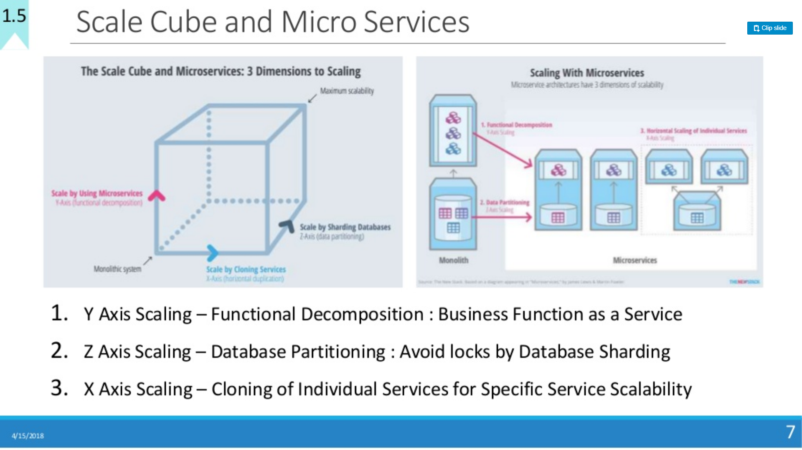

Slide 98
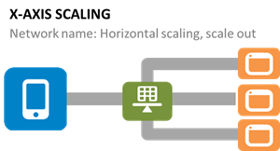
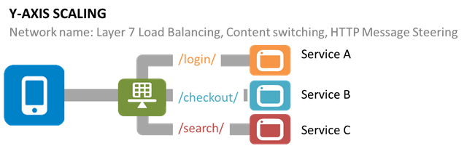
Scaling Challenge

Slide 99
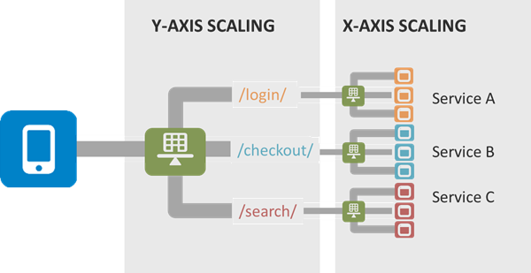
Scaling Challenge

Slide 100

Scaling Challenge

Slide 101
Proposed Solutions to Handle Challenges
1. Data Synchronization — We have event sourcing architecture to address this issue using the async messaging platform. The saga design pattern can address this challenge.
2. Security — An API Gateway can solve these challenges. Kong is very popular and is open-source, and is being used by many companies in production. Custom solutions can also be developed for API security using JWT token, Spring Security, and Netflix Zuul/ Zuul2. There are enterprise solutions available, too, like Apigee and Okta (2-step authentication). Openshift is used for public cloud security for its top features, like Red Hat Linux Kernel-based security and namespace-based app-to-app security.
3. Versioning — This will be taken care of by API registry and discovery APIs using the dynamic Swagger API, which can be updated dynamically and shared with consumers on the server.
4. Discovery — This will be addressed by API discovery tools like Kubernetes and OpenShift. It can also be done using Netflix Eureka at the code level. However, doing it in with the orchestration layer will be better and can be managed by these tools rather doing and maintaining it through code and configuration.

Slide 102
Proposed Solutions to Handle Challenges
5. Data Staleness — The database should be always updated to give recent data. The API will fetch data from the recent and updated database. A timestamp entry can also be added with each record in the database to check and verify the recent data. Caching can be used and customized with an acceptable eviction policy based on business requirements.
6. Debugging and Logging — There are multiple solutions for this. Externalized logging can be used by pushing log messages to an async messaging platform like Kafka, Google PubSub, etc. A correlation ID can be provided by the client in the header to REST APIs to track the relevant logs across all the pods/Docker containers. Also, local debugging can be done individually on each microservice using the IDE or checking the logs.
7. Testing — This issue can be addressed with unit testing by mocking REST APIs or integrated/dependent APIs which are not available for testing using WireMock, BDD, Cucumber, integration testing, performance testing using JMeter, and any good profiling tool like Jprofiler, DynaTrace, YourToolKit, VisualVM, etc.

Slide 103
Proposed Solutions to Handle Challenges
8. Monitoring — Monitoring can be done using open-source tools like Prometheus in combination with Grafana by creating gauge and matrices, Kubernetes/OpensShift, Influx DB, Apigee, combined with Grafana, and Graphite.
9. DevOps Support — Microservices deployment and support-related challenges can be addressed using state-of-the-art DevOps tools like GCP, Kubernetes, and OpenShift with Jenkins.
10. Fault Tolerance — Netflix Hystrix can be used to break the circuit if there is no response from the API for the given SLA/ETA.

Slide 104

Microservices Inter-Service Communication

Slide 105
Microservices Inter-Service Communication
In Microservice Architecture, we can classify our inter-service communication into two approaches like the following:
Synchronous communication style
Asynchronous communication style

Slide 106

Synchronous communication style
The client sends a request to the server and waits for a response from the service (Mostly JSON over HTTP).
For example, Spring Cloud Netflix provides the most common pattern for synchronous REST communication such as Feign or Hystrix.

Slide 107
Synchronous communication style
The synchronous communication approach does have some drawbacks, such as timeouts and strong coupling.
There are numerous protocols, such as REST, gRPC, and Apache Thrift, that can be used to interact with services synchronously.

Slide 108
Synchronous one-to-one communication style
Most synchronous communications are one-to-one.
In synchronous one-to-one communication, you can also use multiple instances of a service to scale the service.
However, if you do, you have to use a load-balancing mechanism on the client side.
Each service contains meta-information about all instances of the calling service.
This information is provided by the service discovery server, an example of which is Netflix Eureka.

Slide 109

Synchronous one-to-one communication style
There are several load-balancing mechanisms you can use.
One of these is Netflix Ribbon, which carries out load-balancing on the client side, as illustrated in the following diagram:

Slide 110
Synchronous one-to-one communication style
As you can see in the preceding diagram, we have multiple instances of a particular service, but the services are still communicating one-to-one.
That means that each service communicates to an instance of another service.
The load balancer chooses which method should be called.
The following is a list of some of the most common load-balancing methods available:
Round-Robin: This is the simplest method that routes requests across all the instances sequentially.
Least Connections: This is a method in which the request goes to the instance that has the fewest number of connections at the time.
Weighted Round-Robin: This is an algorithm that assigns a weight to each instance and forwards the connection according to this weight.
IP Hash: This is a method that generates a unique hash key from the source IP address and determines which instance receives the request.

Slide 111
Asynchronous communication style
In this communication style, the client service doesn’t wait for the response coming from another service.
So, the client doesn’t block a thread while it is waiting for a response from the server. Such type of communications is possible by using lightweight messaging brokers.
The message producer service doesn’t wait for a response.
It just generates a message and sends message to the broker.
It waits for the only acknowledgement from the message broker to know the message has been received by a message broker or not.

Slide 112

Asynchronous communication style
The Order Service generates a message to A Message Broker and then forgets about it.
The Book Service that subscribes to a topic is fed with all the messages belonging to that topic.
The services don’t need to know each other at all, they just need to know that messages of a certain type exist with a certain payload.

Slide 113
Asynchronous communication style
There are various tools to support lightweight messaging, you just choose one of the following message brokers that is delivering your messages to consumers running on respective microservices:
RabbitMQ
Apache Kafka
Apache ActiveMQ
NSQ
The above tools are based on the AMQP (Advanced Message Queuing Protocol).
This protocol provides messaging based inter-service communication.
Spring Cloud Stream also provides mechanisms for building message-driven microservices using either the RabbitMQ or the Apache Kafka.

Slide 114
Asynchronous communication style
Asynchronous one-to-one communication style
Asynchronous one-to-many communication style

Slide 115

Asynchronous one-to-one communication style

Slide 116
Asynchronous one-to-many communication style
Publish/subscribe: In this approach, a Client publishes a notification message to the message broker and this notification message is consumed by zero or more interesting services.
Publish/async responses: In this approach, a Client publishes a request message and then waits for a certain amount of time for responses from interested services

Slide 117

Asynchronous one-to-many communication style

Slide 118

Connecting Microservices Through Messaging
Spring Cloud Stream
It is a framework for building highly scalable event-driven microservices connected with shared messaging systems.
The framework provides a flexible programming model built on already established and familiar Spring idioms and best practices, including support for persistent pub/sub semantics, consumer groups, and stateful partitions.

Slide 119


Slide 120
Binder Implementations
Spring Cloud Stream supports a variety of binder implementations
RabbitMQ
Apache Kafka
Kafka Streams
Amazon Kinesis
Google PubSub (partner maintained)
Solace PubSub+ (partner maintained)
Azure Event Hubs (partner maintained)
Apache RocketMQ (partner maintained)

Slide 121

Rabbitmq Architectural Pattern

Slide 122
Rabbitmq Standard Exchange
The producer publishes a message to the exchange.
The exchange receives the message and is now responsible for the routing of the message.
Binding must be set up between the queue and the exchange. In this case, we have bindings to two different queues from the exchange. The exchange routes the message into the queues.
The messages stay in the queue until they are handled by a consumer.
The consumer handles the message.

Slide 123

Rabbitmq Standard Exchange

Slide 124
Exchange types - Direct Exchange
A direct exchange delivers messages to queues based on a message routing key.
The routing key is a message attribute added to the message header by the producer.
Think of the routing key as an "address" that the exchange is using to decide how to route the message.
A message goes to the queue(s) with the binding key that exactly matches the routing key of the message.

Slide 125

Exchange types - Direct Exchange

Slide 126
Exchange types - Default exchange
The default exchange is a pre-declared direct exchange with no name, usually referred by an empty string.
When you use default exchange, your message is delivered to the queue with a name equal to the routing key of the message.
Every queue is automatically bound to the default exchange with a routing key which is the same as the queue name.

Slide 127
Exchange types - Topic Exchange
Topic exchanges route messages to queues based on wildcard matches between the routing key and the routing pattern, which is specified by the queue binding.
Messages are routed to one or many queues based on a matching between a message routing key and this pattern.

Slide 128

Exchange types - Topic Exchange

Slide 129
Exchange Types - Fanout Exchange
A fanout exchange copies and routes a received message to all queues that are bound to it regardless of routing keys or pattern matching as with direct and topic exchanges. The keys provided will simply be ignored.
Fanout exchanges can be useful when the same message needs to be sent to one or more queues with consumers who may process the same message in different ways.

Slide 130

Exchange Types - Fanout Exchange

Slide 131
Exchange Types Headers Exchange
A headers exchange routes messages based on arguments containing headers and optional values.
Headers exchanges are very similar to topic exchanges, but route messages based on header values instead of routing keys.
A message matches if the value of the header equals the value specified upon binding.

Slide 132

Rabbitmq – Headers Exchange

Slide 133
Exchange Type - DLQ
If no matching queue can be found for the message, the message is silently dropped. RabbitMQ provides an AMQP extension known as the "Dead Letter Exchange", which provides the functionality to capture messages that are not deliverable.

Slide 134
Core Components of Cloud Stream
The core building blocks of Spring Cloud Stream are:
Destination Binders: Components responsible to provide integration with the external messaging systems.
Destination Bindings: Bridge between the external messaging systems and application provided Producers and Consumers of messages (created by the Destination Binders).
Message: The canonical data structure used by producers and consumers to communicate with Destination Binders (and thus other applications via external messaging systems).

Slide 135

Core Components of Cloud Stream

Slide 136

Core Components of Cloud Stream

Slide 137
Asynchronous communication in Microservices
Kafka
RabbitMQ
Google Pub/Sub
Amazon Services
ActiveMQ
Azure Services

Slide 138
What is ZooKeeper
ZooKeeper is a centralized service for maintaining configuration information, naming, providing distributed synchronization, and providing group services.
All of these kinds of services are used in some form or another by distributed applications.
Each time they are implemented there is a lot of work that goes into fixing the bugs and race conditions that are inevitable.
Because of the difficulty of implementing these kinds of services, applications initially usually skimp on them, which make them brittle in the presence of change and difficult to manage.
Even when done correctly, different implementations of these services lead to management complexity when the applications are deployed.

Slide 139
What is ZooKeeper?
Apache ZooKeeper plays the very important role in system architecture as it works in the shadow of more exposed Big Data tools, as Apache Spark or Apache Kafka.
Originally, the ZooKeeper framework was built at “Yahoo!”. Because it helps to access their applications in an easy manner.

Slide 140


Slide 141
Why Zookeeper
It allows for mutual exclusion and cooperation between server processes.
It ensures that your application runs consistently.
The transaction process is never completed partially. It is either given the status of Success or failure. The distributed state can be held up, but it's never wrong.
Irrespective of the server that it connects to, a client will be able to see the same view of the service
Helps you to encode the data as per the specific set of rules

Slide 142
Why Zookeeper
It helps to maintain a standard hierarchical namespace similar to files and directories.
Computers, which run as a single system which can be locally or geographically connected.
It allows to Join/leave node in a cluster and node status at the real time
You can increase performance by deploying more machines.
It allows you to elect a node as a leader for better coordination.
ZooKeeper works fast with workloads where reads to the data are more common than writes.

Slide 143

ZooKeeper Architecture: How it works?

Slide 144

ZooKeeper Architecture: How it works?

Slide 145
ZooKeeper Architecture
Server: The server sends an acknowledge when any client connects. In the case when there is no response from the connected server, the client automatically redirects the message to another server.
Client: Client is one of the nodes in the distributed application cluster. It helps you to accesses information from the server. Every client sends a message to the server at regular intervals that helps the server to know that the client is alive.

Slide 146
ZooKeeper Architecture
Leader: One of the servers is designated a Leader. It gives all the information to the clients as well as an acknowledgment that the server is alive. It would performs automatic recovery if any of the connected nodes failed.
Follower: Server node which follows leader instruction is called a follower.
Client read requests are handled by the correspondingly connected Zookeeper server
The client writes requests are handled by the Zookeeper leader.

Slide 147
ZooKeeper Architecture
Ensemble/Cluster: Group of Zookeeper servers which is called ensemble or a Cluster. You can use ZooKeeper infrastructure in the cluster mode to have the system at the optimal value when you are running the Apache.
ZooKeeper WebUI: If you want to work with ZooKeeper resource management, then you need to use WebUI. It allows working with ZooKeeper using the web user interface, instead of using the command line. It offers fast and effective communication with the ZooKeeper application.

Slide 148

What is ZooKeeper?

Slide 149

ZooKeeper in Kafka

Slide 150
Companies using Zookeeper
Yahoo
Facebook
eBay
Twitter
Netflix
Zynga
Nutanix

Slide 151
What is Kafka
Kafka consists of Records, Topics, Consumers, Producers, Brokers, Logs, Partitions, and Clusters. Records can have key (optional), value and timestamp.
Kafka Records are immutable.
A Kafka Topic is a stream of records ("/orders", "/user-signups").
You can think of a Topic as a feed name.
A topic has a Log which is the topic’s storage on disk.
A Topic Log is broken up into partitions and segments.

Slide 152
What is Kafka
The Kafka Producer API is used to produce streams of data records.
The Kafka Consumer API is used to consume a stream of records from Kafka.
A Broker is a Kafka server that runs in a Kafka Cluster.
Kafka Brokers form a cluster.
The Kafka Cluster consists of many Kafka Brokers on many servers.
Broker sometimes refer to more of a logical system or as Kafka as a whole.

Slide 153


Slide 154


Slide 155

Why Kafka

Slide 156

Why Kafka

Slide 157


Slide 158

Kafka brokers and Zookeeper

Slide 159

Kafka brokers and Zookeeper

Slide 160

Kafka brokers and Zookeeper

Slide 161

Kafka brokers and Zookeeper

Slide 162

Kafka brokers and Zookeeper

Slide 163

Kafka brokers and Zookeeper

Slide 164

Kafka brokers and Zookeeper

Slide 165

Kafka brokers and Zookeeper

Slide 166

Kafka brokers and Zookeeper

Slide 167

Kafka brokers and Zookeeper

Slide 168

Kafka brokers and Zookeeper

Slide 169

Kafka brokers and Zookeeper

Slide 170

Kafka brokers and Zookeeper

Slide 171


Slide 172


Slide 173
ZooKeeper in Kafka
Kafka needs ZooKeeper
Kafka uses Zookeeper to do leadership election of Kafka Broker and Topic Partition pairs.
Kafka uses Zookeeper to manage service discovery for Kafka Brokers that form the cluster.
Zookeeper sends changes of the topology to Kafka, so each node in the cluster knows when a new broker joined, a Broker died, a topic was removed or a topic was added, etc.
Zookeeper provides an in-sync view of Kafka Cluster configuration.

Slide 174


Slide 175

Kafka architecture

Slide 176

Kafka architecture

Slide 177

Go to
E:\software\A08\file\apache-zookeeper-3.5.6-bin.tar\apache-zookeeper-3.5.6-bin\apache-zookeeper-3.5.6-bin\conf
Zkserver from command prompt

Slide 178


Slide 179


Slide 180


Slide 181

Process the incoming messages, filter and split into multiple topics based on certain conditions.

Slide 182
RabbitMQ
The super simplified overview:
Publishers send messages to exchanges
Exchanges route messages to queues and other exchanges
RabbitMQ sends acknowledgements to publishers on message receipt
Consumers maintain persistent TCP connections with RabbitMQ and declare which queue(s) they consume
RabbitMQ pushes messages to consumers
Consumers send acknowledgements of success/failure
Messages are removed from queues once consumed successfully

Slide 183


Slide 184
Solutions to Challenges with Microservice Architectures
Spring Cloud
Spring Cloud provides solutions to cloud enable your microservices.
It leverages and builds on top of some of the Cloud solutions opensourced by Netflix (Netflix OSS).

Slide 185

Spring Cloud

Slide 186
Spring Cloud
Spring Cloud provides tools for developers to quickly build some of the common patterns in distributed systems (e.g. configuration management, service discovery, circuit breakers, intelligent routing, micro-proxy, control bus, one-time tokens, global locks, leadership election, distributed sessions, cluster state).
Coordination of distributed systems leads to boiler plate patterns, and using Spring Cloud developers can quickly stand up services and applications that implement those patterns.
They will work well in any distributed environment, including the developer’s own laptop, bare metal data centres, and managed platforms such as Cloud Foundry.

Slide 187
Spring Cloud Main Projects
Spring Cloud Config
Centralized external configuration management backed by a git repository.
The configuration resources map directly to Spring Environment but could be used by non-Spring applications if desired.
Spring Cloud Netflix
Integration with various Netflix OSS components (Eureka, Hystrix, Zuul, Archaius, etc.).

Slide 188
Spring Cloud Main Projects
Spring Cloud Bus
An event bus for linking services and service instances together with distributed messaging. Useful for propagating state changes across a cluster (e.g. config change events).
Spring Cloud Cloudfoundry
Integrates your application with Pivotal Cloud Foundry. Provides a service discovery implementation and also makes it easy to implement SSO and OAuth2 protected resources.

Slide 189
Spring Cloud Main Projects
Spring Cloud Open Service Broker
Provides a starting point for building a service broker that implements the Open Service Broker API.
Spring Cloud Cluster
Leadership election and common stateful patterns with an abstraction and implementation for Zookeeper, Redis, Hazelcast, Consul.

Slide 190
Spring Cloud Main Projects
Spring Cloud Consul
Service discovery and configuration management with Hashicorp Consul.
Spring Cloud Security
Provides support for load-balanced OAuth2 rest client and authentication header relays in a Zuul proxy.
Spring Cloud Sleuth
Distributed tracing for Spring Cloud applications, compatible with Zipkin, HTrace and log-based (e.g. ELK) tracing.

Slide 191
Spring Cloud Main Projects
Spring Cloud Data Flow
A cloud-native orchestration service for composable microservice applications on modern runtimes. Easy-to-use DSL, drag-and-drop GUI, and REST-APIs together simplifies the overall orchestration of microservice based data pipelines.
Spring Cloud Stream
A lightweight event-driven microservices framework to quickly build applications that can connect to external systems. Simple declarative model to send and receive messages using Apache Kafka or RabbitMQ between Spring Boot apps.

Slide 192
Spring Cloud Main Projects
Spring Cloud Stream App Starters
Spring Cloud Stream App Starters are Spring Boot based Spring Integration applications that provide integration with external systems.
Spring Cloud Task
A short-lived microservices framework to quickly build applications that perform finite amounts of data processing. Simple declarative for adding both functional and non-functional features to Spring Boot apps.

Slide 193
Spring Cloud Main Projects
Spring Cloud Task App Starters
Spring Cloud Task App Starters are Spring Boot applications that may be any process including Spring Batch jobs that do not run forever, and they end/stop after a finite period of data processing.
Spring Cloud Zookeeper
Service discovery and configuration management with Apache Zookeeper.

Slide 194
Spring Cloud Main Projects
Spring Cloud AWS
Easy integration with hosted Amazon Web Services. It offers a convenient way to interact with AWS provided services using well-known Spring idioms and APIs, such as the messaging or caching API. Developers can build their application around the hosted services without having to care about infrastructure or maintenance.
Spring Cloud Connectors
Makes it easy for PaaS applications in a variety of platforms to connect to backend services like databases and message brokers (the project formerly known as "Spring Cloud").

Slide 195
Spring Cloud Main Projects
Spring Cloud Starters
Spring Boot-style starter projects to ease dependency management for consumers of Spring Cloud. (Discontinued as a project and merged with the other projects after Angel.SR2.)
Spring Cloud CLI
Spring Boot CLI plugin for creating Spring Cloud component applications quickly in Groovy
Spring Cloud Contract
Spring Cloud Contract is an umbrella project holding solutions that help users in successfully implementing the Consumer Driven Contracts approach.

Slide 196
Spring Cloud Main Projects
Spring Cloud Gateway
Spring Cloud Gateway is an intelligent and programmable router based on Project Reactor.
Spring Cloud OpenFeign
Spring Cloud OpenFeign provides integrations for Spring Boot apps through autoconfiguration and binding to the Spring Environment and other Spring programming model idioms.
Spring Cloud Pipelines
Spring Cloud Pipelines provides an opinionated deployment pipeline with steps to ensure that your application can be deployed in zero downtime fashion and easilly rolled back of something goes wrong.

Slide 197
Spring Cloud Main Projects
Spring Cloud Function
Spring Cloud Function promotes the implementation of business logic via functions. It supports a uniform programming model across serverless providers, as well as the ability to run standalone (locally or in a PaaS).
.

Slide 198
Spring Cloud Config Server
Spring Cloud Config provides server and client-side support for externalized configuration in a distributed system.
With the Config Server you have a central place to manage external properties for applications across all environments.
The concepts on both client and server map identically to the Spring Environment and PropertySource abstractions, so they fit very well with Spring applications, but can be used with any application running in any language.

Slide 199
Spring Cloud Config Server
As an application moves through the deployment pipeline from dev to test and into production you can manage the configuration between those environments and be certain that applications have everything they need to run when they migrate.
The default implementation of the server storage backend uses git so it easily supports labelled versions of configuration environments, as well as being accessible to a wide range of tooling for managing the content. It is easy to add alternative implementations and plug them in with Spring configuration.

Slide 200
Features
Spring Cloud Config Server features:
HTTP, resource-based API for external configuration (name-value pairs, or equivalent YAML content)
Encrypt and decrypt property values (symmetric or asymmetric)
Embeddable easily in a Spring Boot application using @EnableConfigServer

